Slide 1
Acquittal Search
Developed by :
Vidit Agarwal
J S Radhe Shyam
Gaurav Badola
Vyshakh Raju

Slide 2
What is “Acquittal Search ”
-> Search engine for helping people to search law related queries
-> In result of query , user will going to see result consisting of cases matching the query
-> Advocate and lawyer details will be displayed for user to help out

Slide 3
Progress done so far :
Module : Database
Our database consists of lawyers details , cases detail from various courts of India .
Cases detail will be :
Case citation
Judge
Court in which case appeared
Apellant & Respondent
Case Judgement by Judge
Result what judge has said

Slide 4
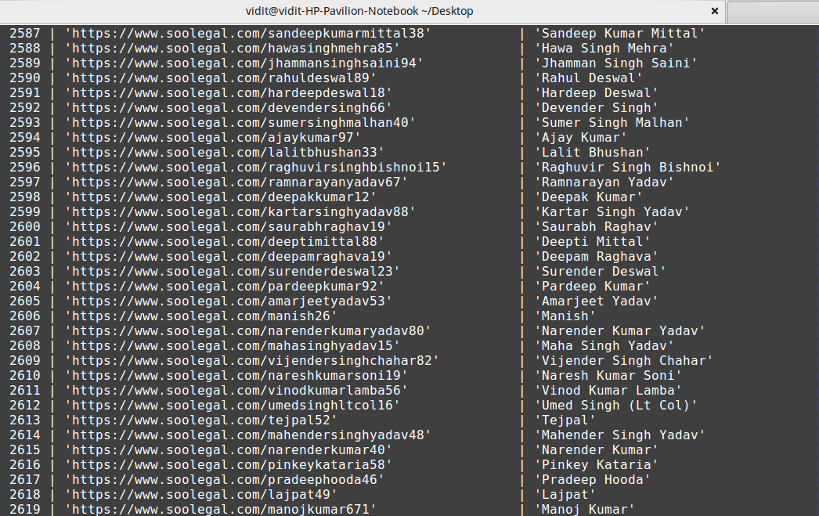
Some snaps :
Lawyers Detail :

Slide 5
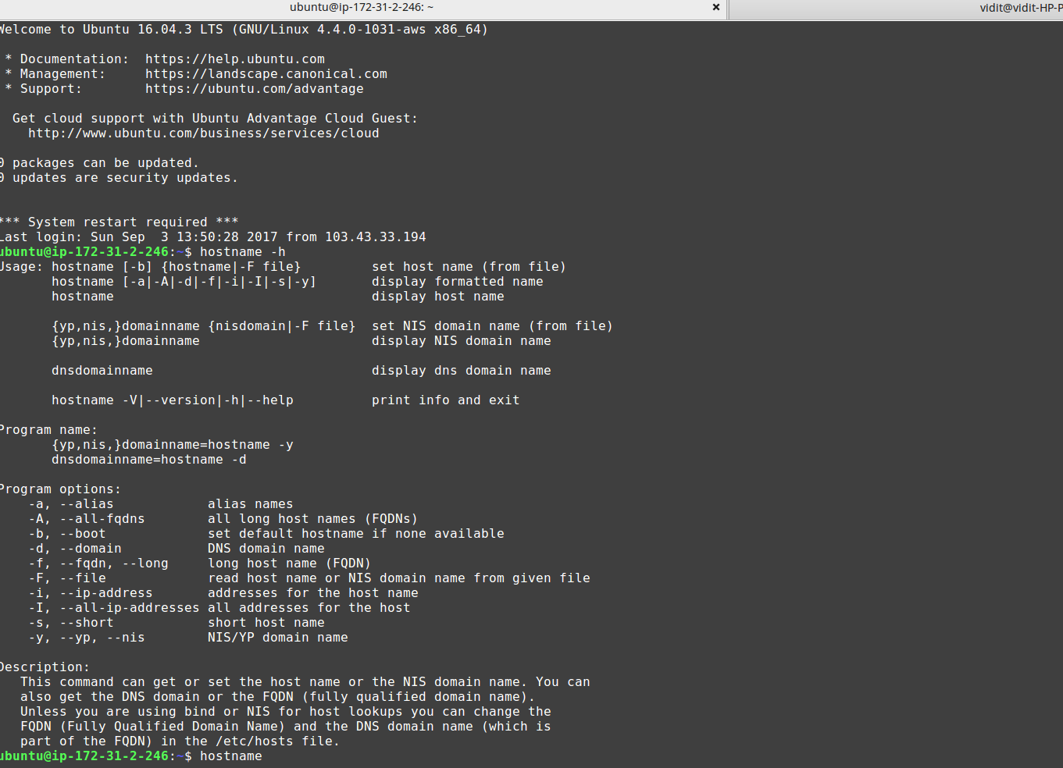
Some snaps :
Server Detail :
hostname -h : ubuntu@172...

Slide 6
What we are working on ?
We are working on module 1: Query analysis module
We are working on finalizing the approach for it .
We have think of 2 approaches for this : → With meta tag
: → Without meta tag
Working on forming db and query analysis side-by-side

